Slide 1
The Role of Judges in Determining the Meaning of Religious Symbols
Religious Freedom Discussion Series
October 27, 2011
Professor Brett G. Scharffs
Part 3

Slide 2
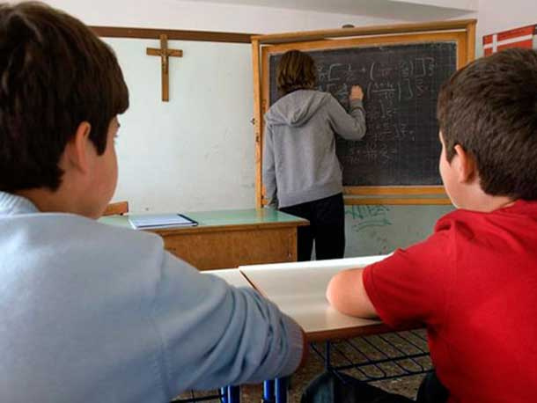
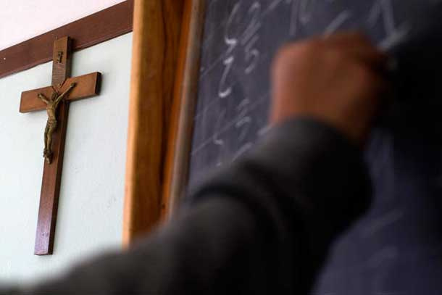
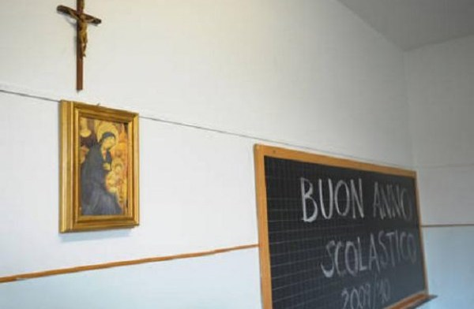
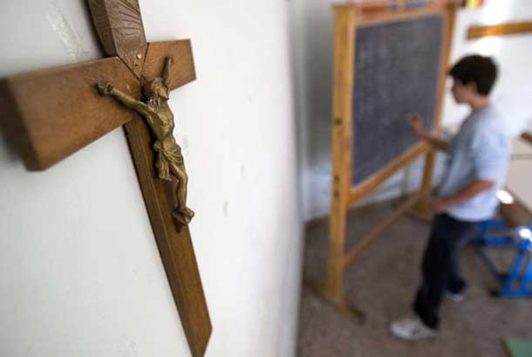
ECHR: Italian Classroom Crucifix Case

Slide 3
Lautsi & Ors. v. Italy (ECtHR (GC), 2011) Description:
In March, 2011, a Grand Chamber of the European Court of Human Rights reversed an earlier panel decision in Lautsi & Ors. v. Italy, holding that the display of crucifixes in the classrooms of Italian state schools was within the margin of appreciation accorded to member states of the Council of Europe
Therefore, it did not violate Article 2 of Protocol No. 1 ECHR (right to education and right of parents to ensure such education is in conformity with their own religious and philosophical convictions)
The Grand Chamber also concluded it was not necessary separately to examine the complaints under Articles 9 (thought, conscience and religion) and 14 (discrimination))

Slide 4
Lautsi & Ors. v. Italy (ECtHR (GC), 2011) Initial Chamber Judgment:
The initial Chamber judgment took the view that while the crucifix may have a plurality of meanings, the religious meaning was predominant. Thus, the display of the crucifix was “incompatible with the State’s duty to respect neutrality in the exercise of public authority, particularly in the field of education.”
Grand Chamber summarizes the Chamber’s reasoning:
“It accordingly considered that the compulsory and highly visible presence of crucifixes in classrooms was capable not only of clashing with the secular convictions of [applicants] , but also of being emotionally disturbing for pupils of non-Christian religions or those who professed no religion.”
Panel judgment, para. 57, quoted in Grand Chamber judgment, at para. 32.

Slide 5
Lautsi & Ors. v. Italy (ECtHR (GC), 2011) Grand Chamber Judgment:
The Grand Chamber agreed that the crucifix is “above all a religious symbol.” It also noted that the Government of Italy explained the presence of the crucifix in classrooms as “being the result of Italy’s historical development,” with both religious and identity-linked connotations, and now “corresponded to a tradition they considered it important to perpetuate.”
They added that, “beyond its religious meaning, the crucifix symbolised the principles and values which formed the foundation of democracy and western civilisation, and that its presence in classrooms was justifiable on that account.”
Grand Chamber judgment, at para. 66, 67.

Slide 6
Lautsi & Ors. v. Italy (ECtHR (GC), 2011) Analysis:
Significantly, the Grand Chamber stepped away from dictating a particular, legally binding conclusion about the meaning of the crucifix.
It noted that various parties and Courts have differing views, and the Constitutional Court of Italy has not given a ruling.
“It is not for the Court to take a position regarding a domestic debate among domestic courts.”
Grand Chamber judgment, at para. 68.

Slide 7
Lautsi & Ors. v. Italy (ECtHR (GC), 2011) Analysis:
The Court exercised what Alexander Bickel has described as a “passive virtue,” declining to give an authoritative answer that would have, in Cover’s words, the jurispathic effect of killing other legal meanings.
By declining to take an absolute position with respect to the meaning of the crucifix, the Court allows various interpretations and significations to continue to exist.

Slide 8
Lautsi & Ors. v. Italy (ECtHR (GC), 2011) Evaluation:
This is a jurisgenerative rather than jurispathic approach to interpreting the meaning of symbols

Slide 9
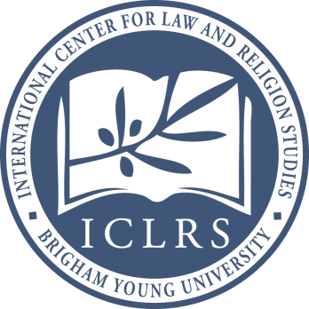
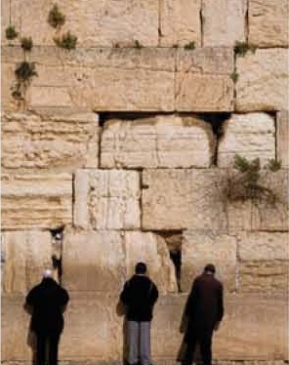
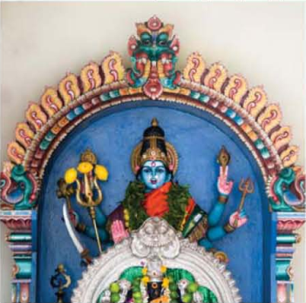
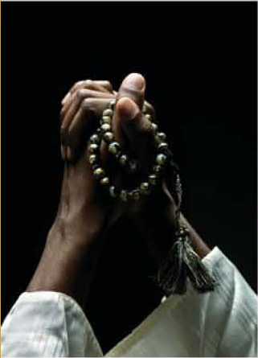
The Many Meanings of the Cross
Lautsi, like so many other cases involving the meaning of a religious symbol, involves one of the most familiar, yet contested and contestable symbols: The Cross
What does the cross mean?

Slide 10
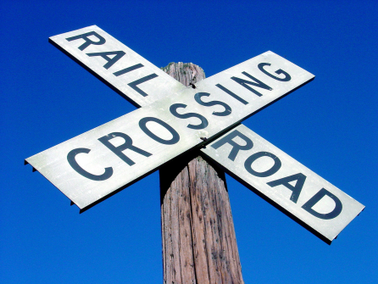
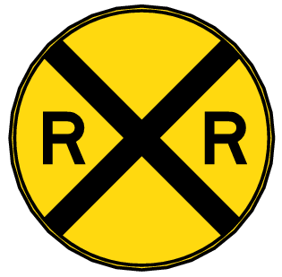
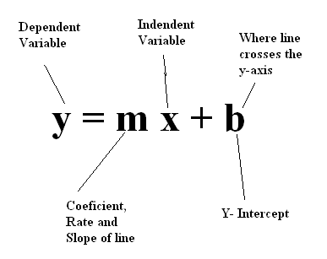
Non-religious crosses
Railroad crossings; mathematical symbols

Slide 11
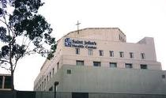
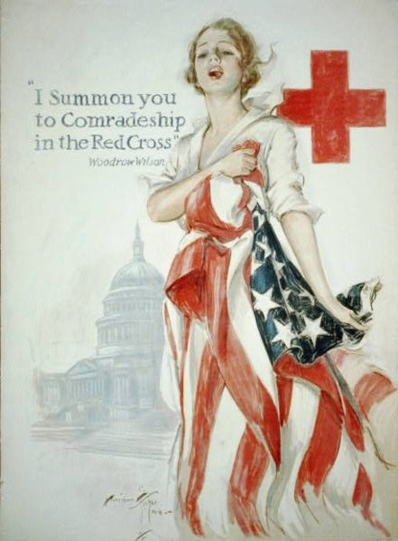
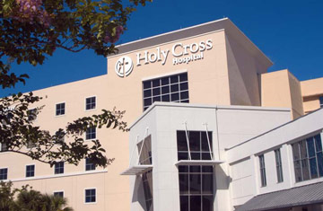
Hospital Crosses

Slide 12
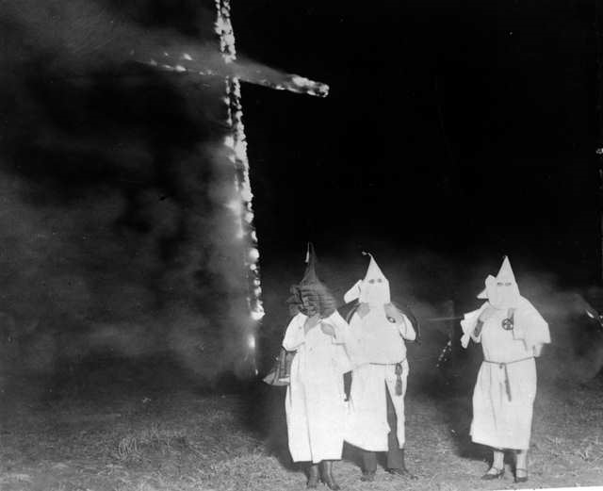
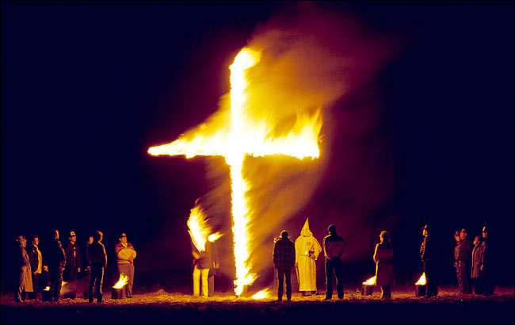
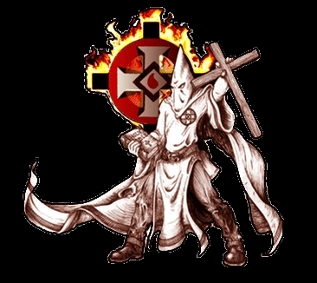
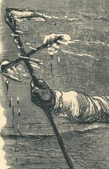
The Burning Cross

Slide 13
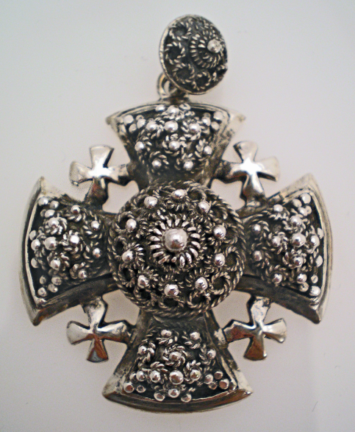
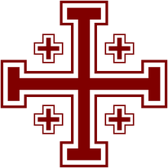
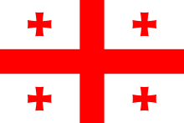
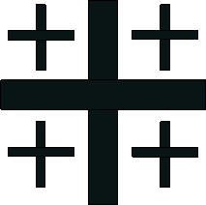
Crusader’s Cross
The Jerusalem cross, also known as Crusaders' cross, is a heraldic cross or Christian symbol consisting of a large Greek cross surrounded by four smaller Greek crosses, one in each quadrant.
The simpler form of the cross is known as the "Crusaders' Cross", because it was on the papal banner given to the Crusaders by Pope Urban II for the First Crusade, and became a symbol of the Latin Kingdom of Jerusalem.

Slide 14
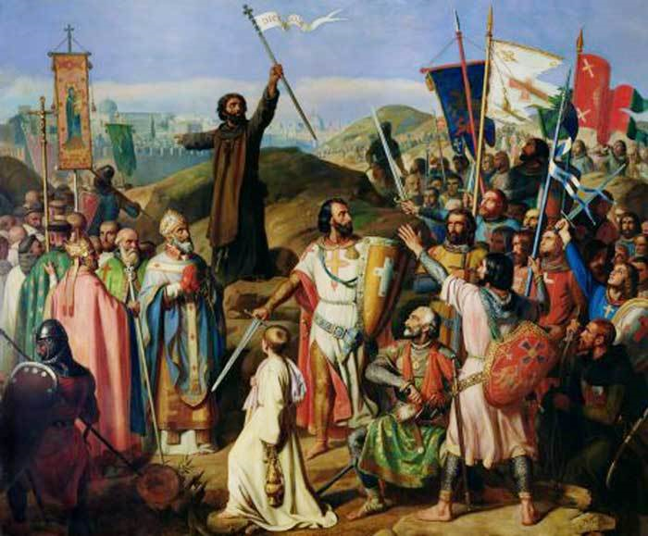
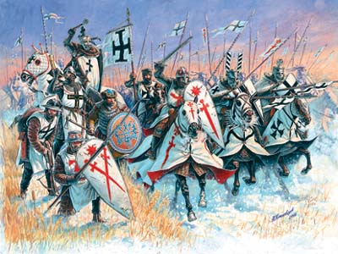
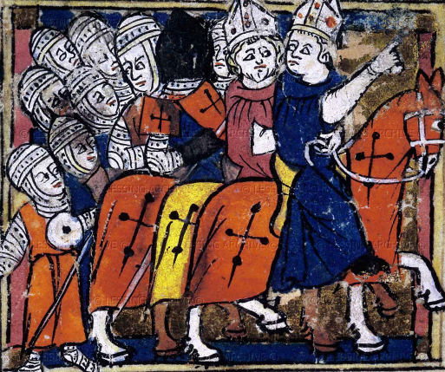
Crosses on Shields

Slide 15
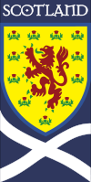
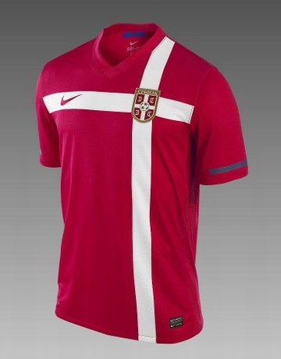
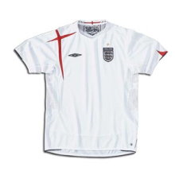
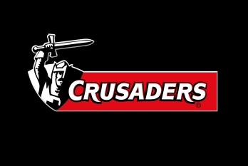
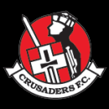
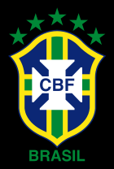
Soccer Crosses
The Crusaders (formerly the Canterbury Crusaders) are a New Zealand professional Rugby union team based in Christchurch that competes in the Super Rugby competition
Crusaders Football Club is a semi-professional, Northern Irish football club, playing in the IFA Partnership.

Slide 16
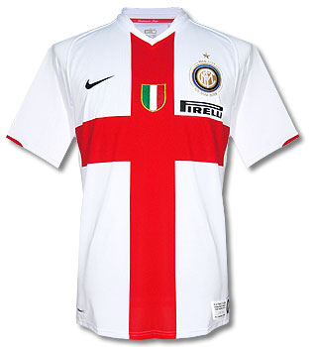
Soccer Crosses
A Turkish lawyer sued Italian soccer giants Inter Milan for “offending Muslim sensibilities” with their current centenary shirt, on the grounds that it is a symbols of the crusades and the “bloody days of the past.” The red cross has been the symbol of Milan for hundreds of years.

Slide 17
Sovereign Flags with Crosses
Georgia
Finland
Norway
Dominican Republic
Switzerland
Burundi
Greece
Serbia
Tonga
Malta
Iceland
Slovakia
United Kingdom
Denmark
Dominica
Jamaica
Sweden
Portugal

Slide 18
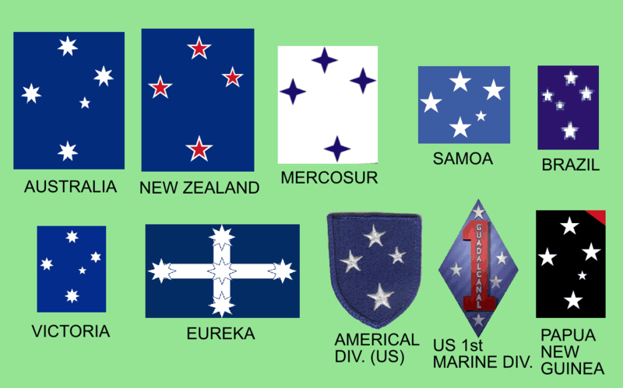
Southern Cross

Slide 19
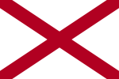
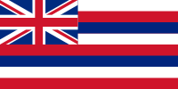
U.S. State Flags with Crosses
Mississippi
Alabama
New Mexico
Florida
Hawaii
Maryland

Slide 20
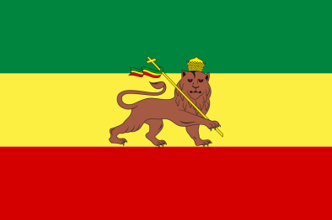
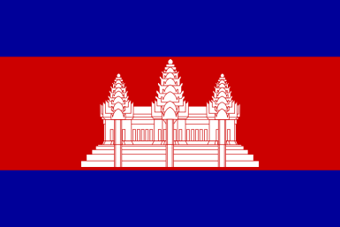
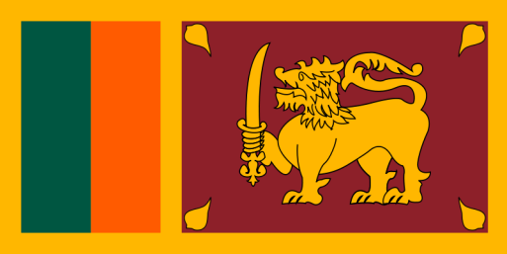
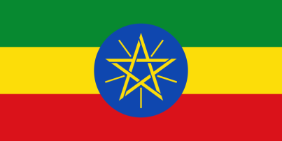
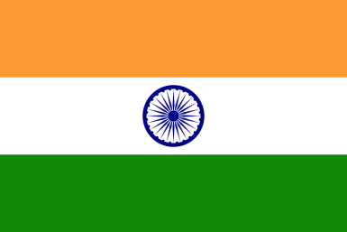
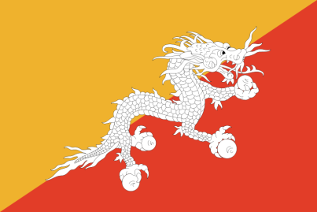
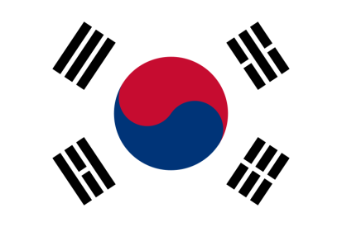
Other Religious Flags
Former Ethiopian flag with the Lion of Judah
Cambodia (Buddhism)
Sri Lanka (Buddhism/Islam)
Current Ethiopian Flag with Star of House of Solomon
India (Buddhism/Hinduism/Islam)
Mongolia (Daoism)
South Korea (Daoism)
Bhutan (Buddhism)
Nepal (Hindu)

Slide 21
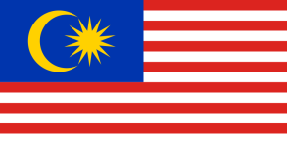
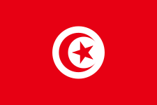
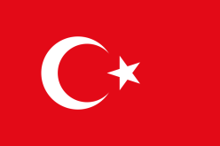
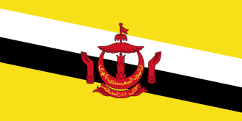
Islamic Flags
Afghanistan
Malaysia
Tunisia
Algeria
Maldives
Turkey
Azerbaijan
Mauritania
Turkmenistan
Brunei
Pakistan
Uzbekistan
Comoros
Kingdom of Saudi Arabia
Singapore
Iran

Slide 22
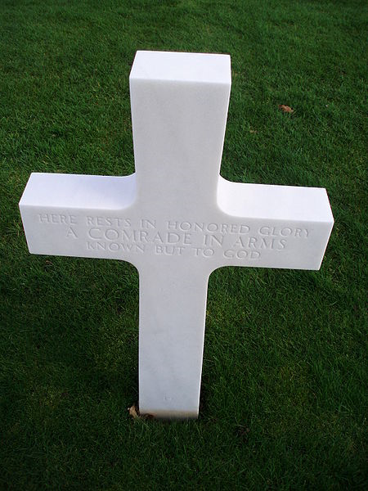
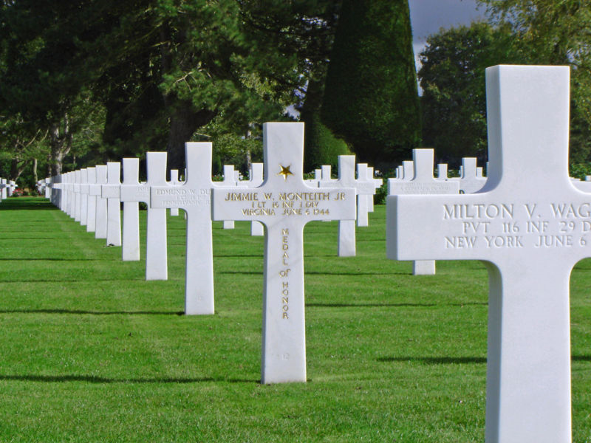
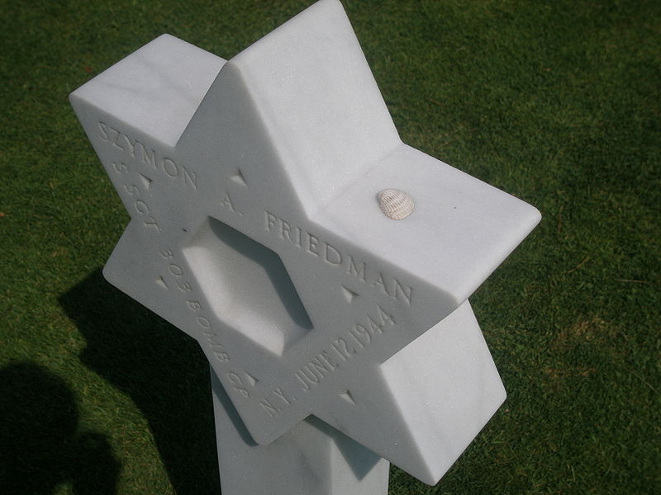
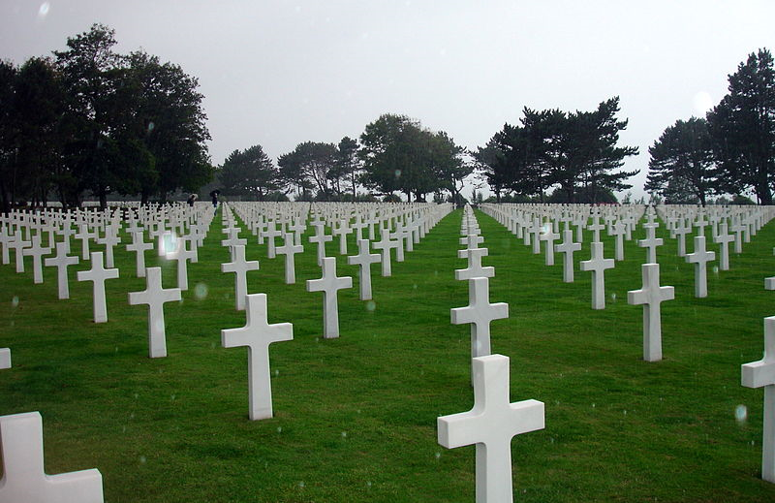
Military Cemeteries (Normandy)

Slide 23
Available Emblems of Belief For Placement on Government Headstones and Markers
Today there are nearly 50 available emblems of belief, and a clear process of applying for additional emblems

Slide 24
The Cross of Sacrifice
The Cross of Sacrifice was designed by Sir Reginald Bloomfield for the Imperial War Graves Commission and is usually present in Commonwealth war cemeteries containing 40 or more graves.
It is normally a freestanding four point limestone Latin cross in one of three sizes ranging in height from 18 to 32 feet.
On the face of the cross is a bronze sword, blade down.
It is usually mounted on an octagonal base.

Slide 25
The Cross of Sacrifice
The Cross represents the faith of the majority of the dead and the sword represents the military character of the cemetery
The sword stands as a universal symbol of selflessness
“The upturned sword shows that the battle has been fought and that those who gave there lives are now mourned.”�Ref- Tyne Cot Visitors Centre

Slide 26
The Cross of Sacrifice
This is the Cross of Sacrifice located in Arlington National Cemetery by the graves of United States citizens who enlisted in the Canadian military, and lost their lives during the First World War.

Slide 27
Conclusion
When confronting symbols, courts should be more self-aware of their jurispathic tendencies – their proclivity to kill alternative conceptions of what symbols mean and to adopt a single “official” conception.
Rather than declaring definitively what symbols mean, often courts should adopt a more modest posture

Slide 28
Conclusion
Rather than taking sides about what contested symbols “really” mean, courts can often recognize that they mean a great many different things to different people.
By refraining from taking sides between those who insist upon imposing a single meaning upon those symbols, courts can allow differing jurisgenerative visions to coexist and compete with each other for our hearts and minds.

Slide 29
Conclusion
When courts give official sanction to a particular interpretation of a symbol, this has the jurispathic effect of killing other competing interpretations.
Generally, this is not simply unnecessary violence, it is deeply antithetical to the very character and purpose of symbols

Slide 30
Thank you

Slide 31
The Role of Judges in Determining the Meaning of Religious Symbols
International Center for Law and Religion Studies
Community Service Outreach Committee, J. Reuben Clark Law Society
Religious Freedom Discussion Series
October 27, 2011
Professor Brett G. Scharffs
Francis R. Kirkham Professor of Law
Associate Director, International Center for Law and Religion Studies
J. Reuben Clark Law School
Brigham Young University

